Slide 1

Mental Health in the Workplace
Project 1
Karlee Crose
Jeffrey Gary
Zachary Horn
Ibraam Masoud

Slide 2

What is
Mental Health?
Mental health refers to a person's emotional, psychological, and social well-being. It affects how individuals think, feel, and behave, influencing how they handle stress, relate to others, and make decisions.

Slide 3

More Common than You Think
1 in 5 adults experienced a mental health concern in the past year.
Mental health can fluctuate due to factors like life experiences, trauma, genetics, and biological factors.

Slide 4

How does work impact mental health?
Positive
Sense of Purpose & Achievement
Social Connections
Financial Stability
Negative
Stress & Burn-Out
Work-Life Imbalance
Job Insecurity
Toxic Work Environment

Slide 5

Learning Agenda
What is the relationship between employer-provided mental health benefits and employees' willingness to discuss mental health?
How do demographic factors influence the likelihood of seeking mental health treatment?
What are the perceived risks of discussing mental health issues at work?
How does remote work or the number of employees in a company impact attitudes toward mental health treatment?

Slide 6
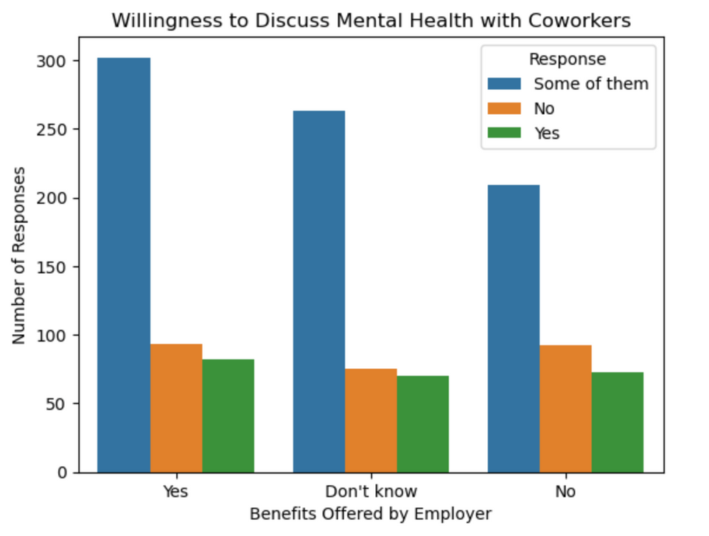
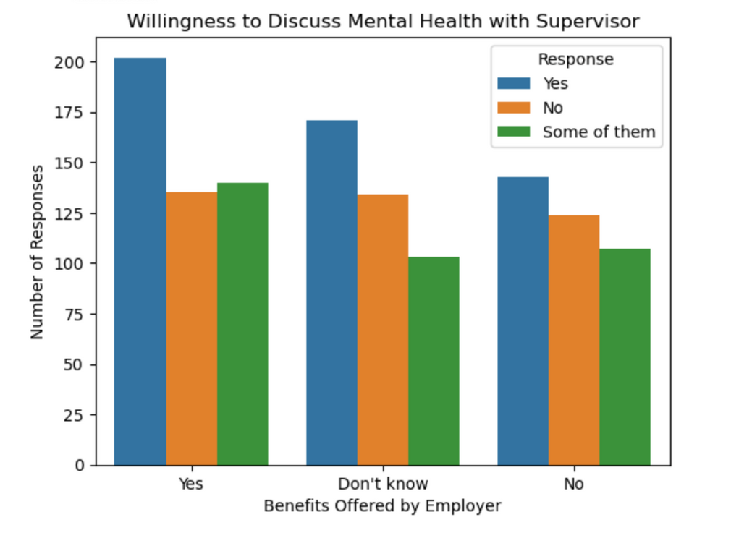
Mental Health Benefits
Offered by Employer

Slide 7
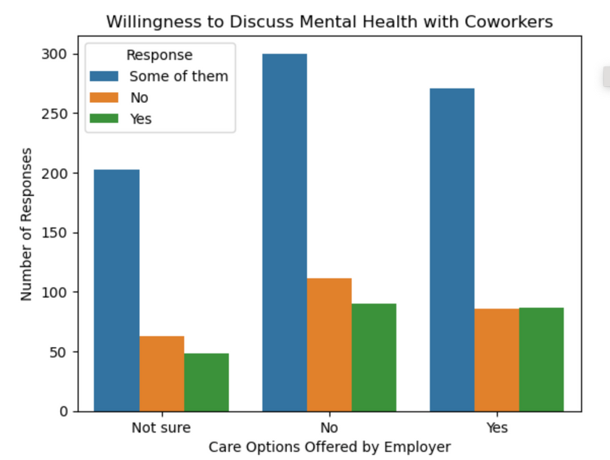

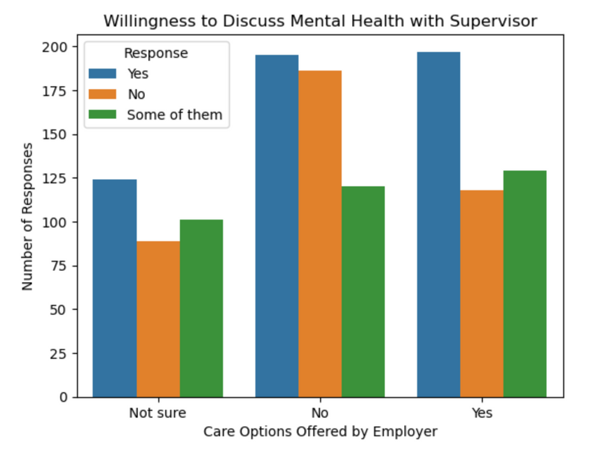
Care Options
Offered by Employer
Employee Assistance Programs (EAPs)
Telehealth Services
Paid Mental Health Days
Flexible Work Arrangements
Parental and Family Care Support
Peer Support Programs

Slide 8
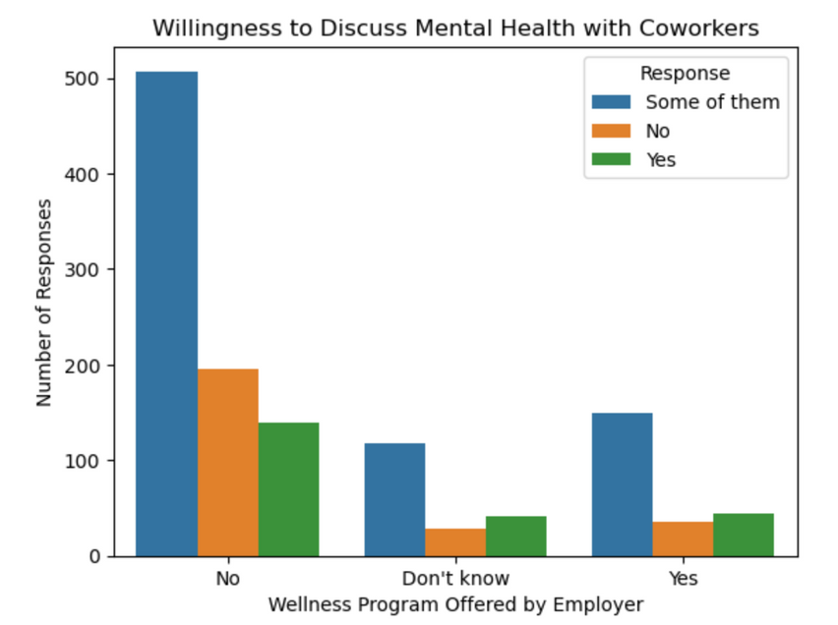
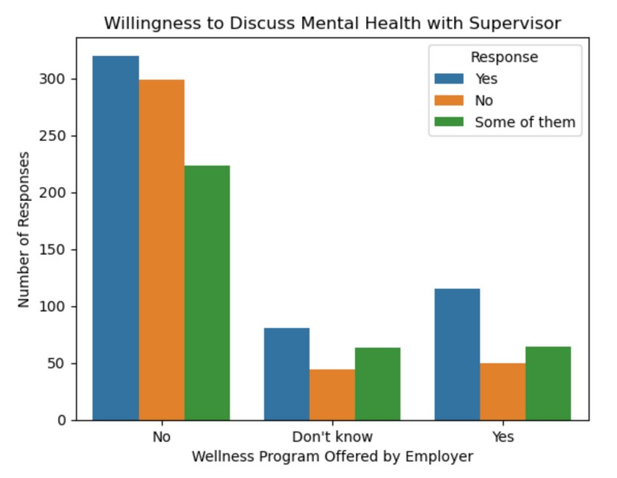
Wellness Program
Offered by Employer
A set of initiatives and activities provided by employers to promote and support the health and well-being of their employees
Health Screenings
Fitness Programs: On-site gyms, yoga classes, discounted memberships
Nutrition Programs
Smoking Cessation Programs
Weight Management

Slide 9

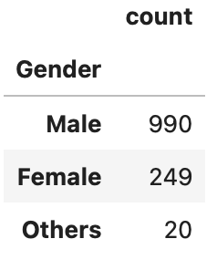

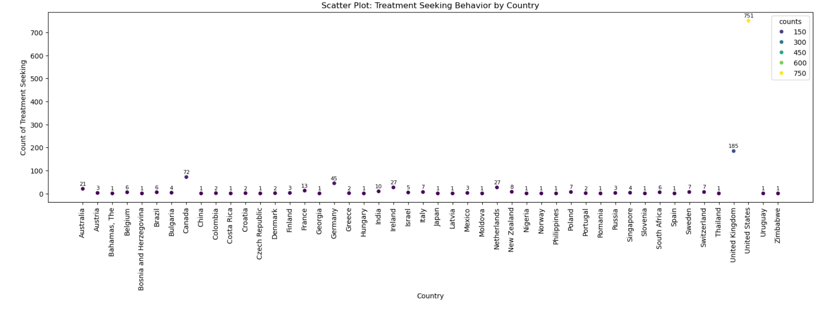
Geographical Impact
Results by Country

Slide 10
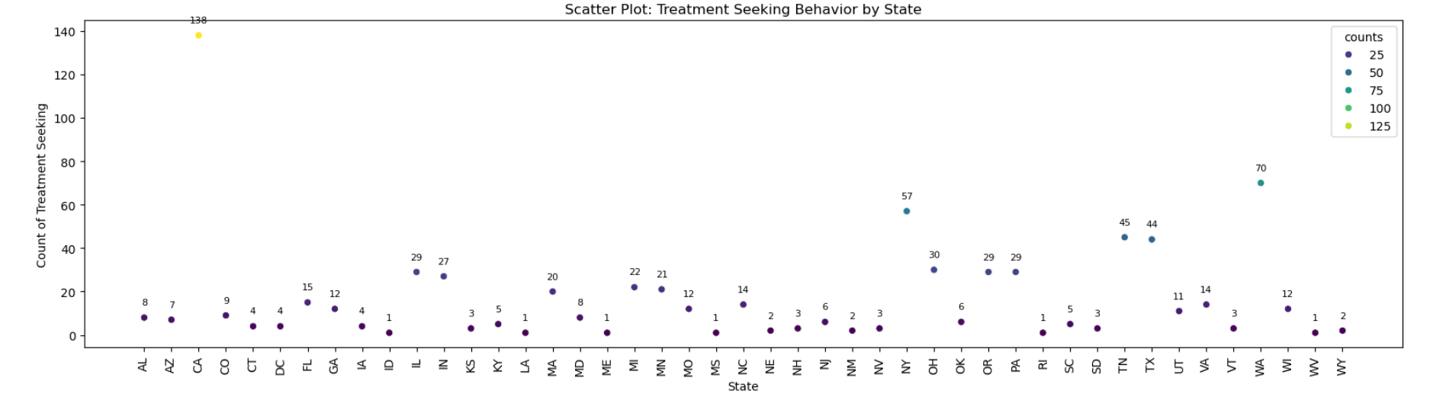
Geographical Impact
Results by State
Highest Rate of Treatment Seeking Employers:
California, Washington, New York

Slide 11
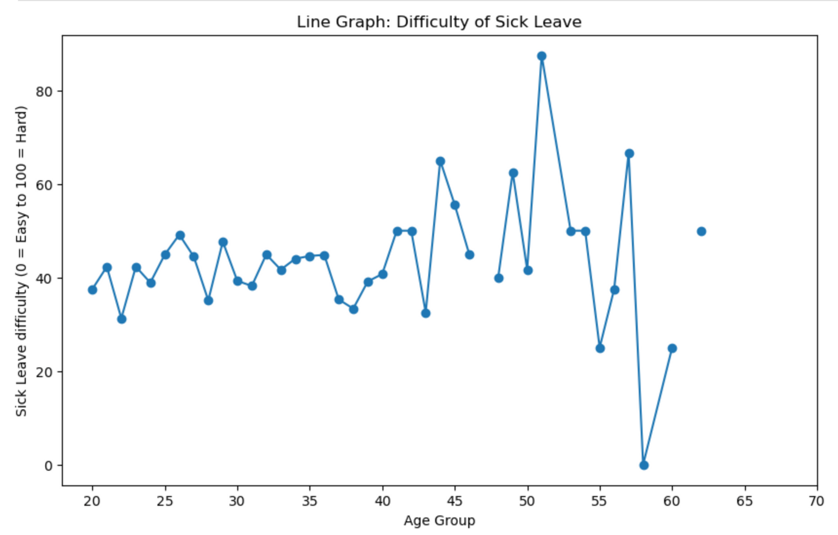
Perceived Difficulty of
Sick Leave

Slide 12

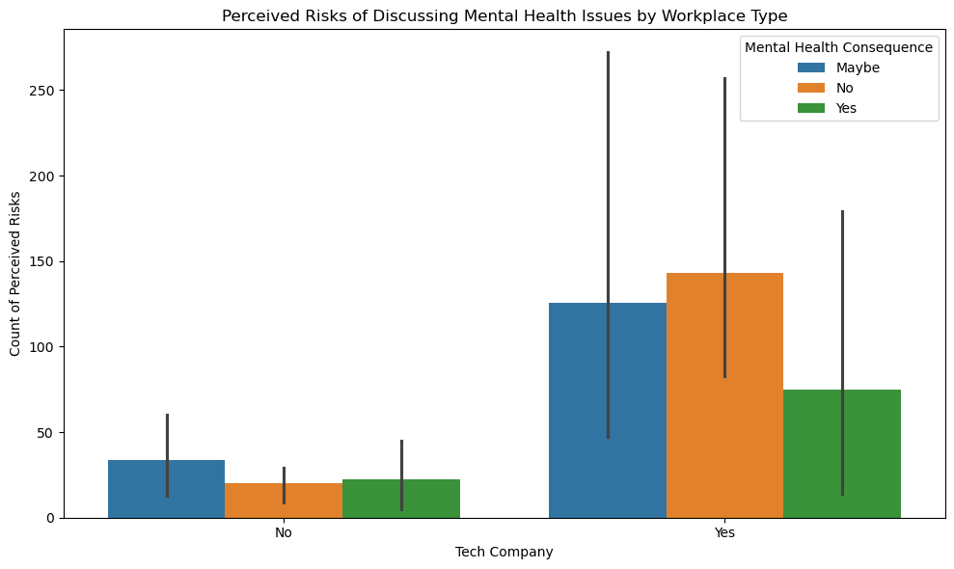
Perceived Risk of
Negative Feedback per Industry
A disproportionate number of tech company employees feel that they would receive negative feedback regarding a mental health problem.

Slide 13
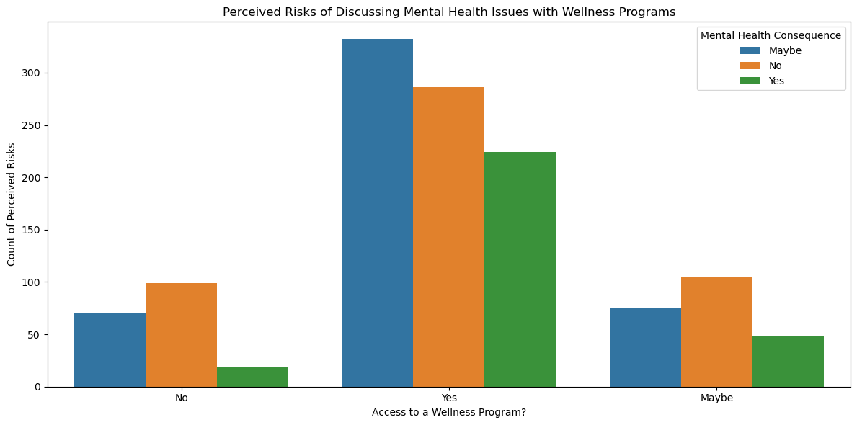
Perceived Risk of
Negative Feedback per Access to Wellness Program
The access to wellness programs does not reduce perceived risk.
Employees seem to still be uncertain about the effectiveness of these programs.

Slide 14

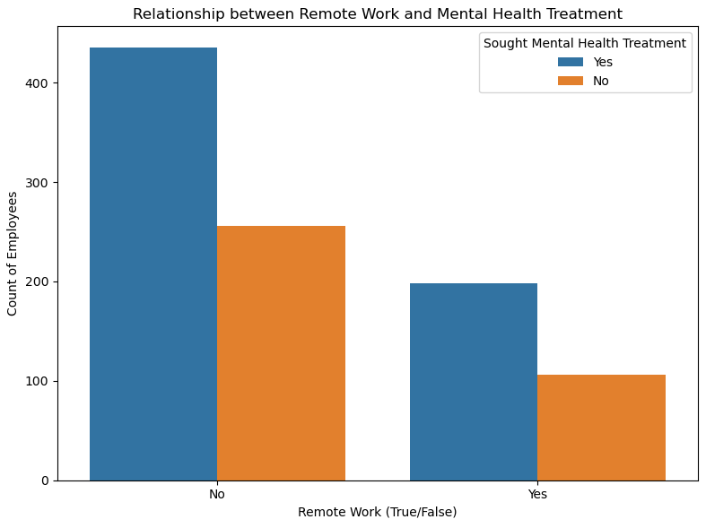
Impact of Remote Work on Treatment Rate
The access to wellness programs does not reduce perceived risk.
Employees seem to still be uncertain about the effectiveness of these programs.

Slide 15
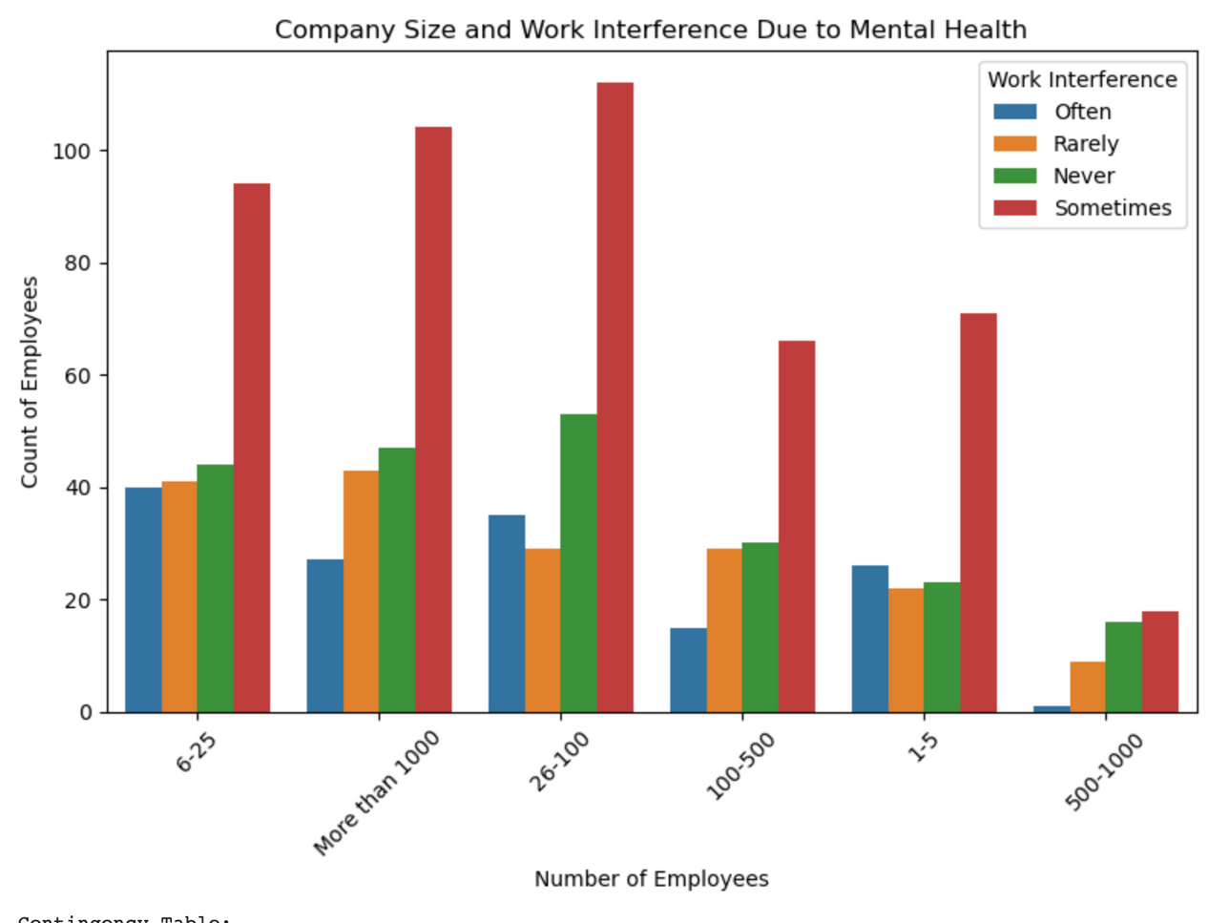
Impact of Company Size on Work Interference
The access to wellness programs does not reduce perceived risk.
Employees seem to still be uncertain about the effectiveness of these programs.

Slide 16
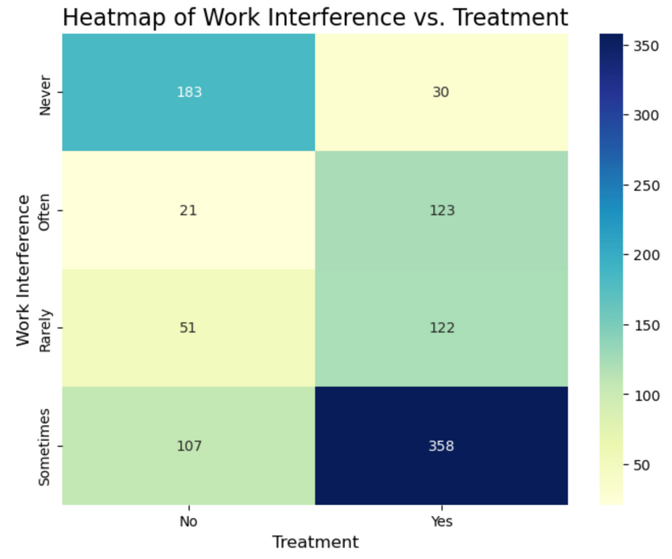
Heat Table
The access to wellness programs does not reduce perceived risk.
Employees seem to still be uncertain about the effectiveness of these programs.

Slide 17

Help Eliminate the Stigma
Encourage Open Conversations
Promote Education and Awareness
Accurate Media Representation
Support Mental Health Advocacy

Slide 18

Thank
You
If you or someone you know needs mental health support, please consider the following resources:
National Alliance on Mental Illness (NAMI)
Mental Health America (MHA)
The Mighty
Substance Abuse and Mental Health Services Administration (SAMHSA)

